Slide 1
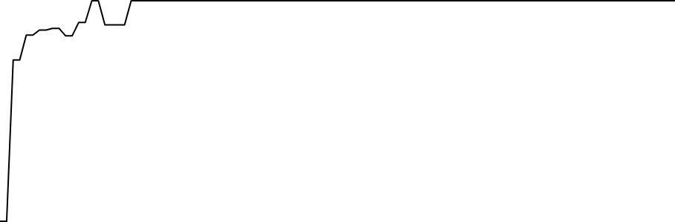
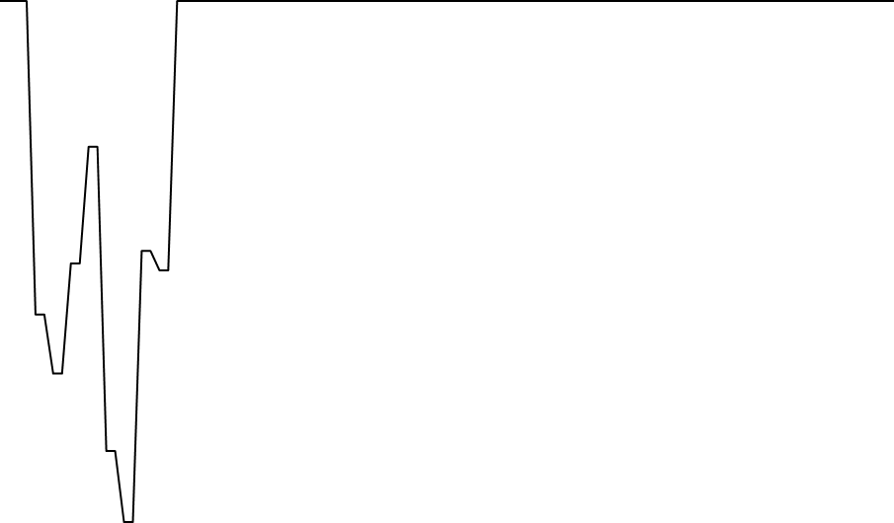
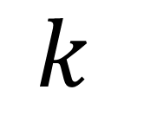
Brightkite
Gowalla
Gowalla
1.00
1.00
1.00
1.0000
0.75
0.75
Proportion of largest
connected component
0.99
0.50
0.50
0.9995
0.98
0.25
0.25
0
25
0
25
0.00
0.00
$$k$$
0
25
50
75
100
0
25
50
75
100

Slide 2
Proportion of Largest k-Core Connected Component
1.00
0.75
Ratio of largest k-core component size to total k-core size
0.50
0.25
0.00
0
25
50
75
100
k (k-core value)

Slide 3
Proportion of Largest k-Core Connected Component
1.00
0.75
Ratio of largest k-core component size to total k-core size
0.50
0.25
0.00
0
25
50
75
100
k (k-core value)

